Slide 1
Marlin Capital Solutions
Process and Benefits for United Rentals
January 2020

Slide 2
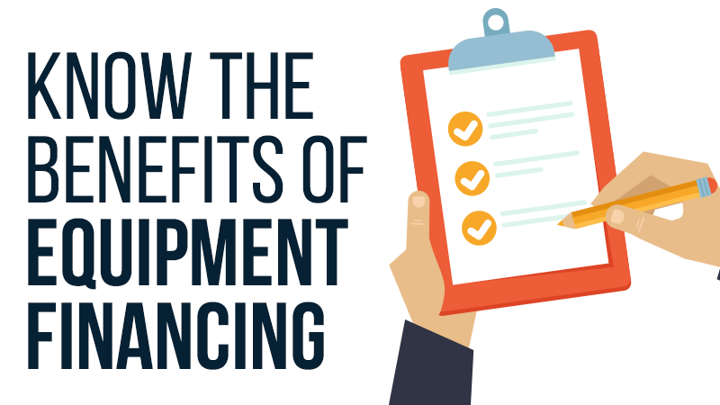
Why Finance? Customer Benefits
$0 down financing
Source of capital
Preserves bank lines and cash
Potential tax advantages (ex: Section 179)
Full project financing
Easy and convenient process
Upgrades and add-ons simplified
Flexible payment options

Slide 3
Why Finance? UR Benefits
Overcome Pricing Objections
Small payment fits budgets easier
Lower Cost of Sale
Small payment closes sales faster, saving you time
Greater Profit Margin
Promote monthly payment instead of discounting
Increase Average Transaction Size
Customers can purchase more with a small payment
Lock In Customer Relationship for Repeat Sales
80% of financing customers continue to use financing for future purchases (source: ELFA)
No Hassle Finance Process
Get updates on transaction status from your Marlin rep

Slide 4
Pitfalls of Not Offering Financing
Greater Risk of Losing the Sale
80% of business customers use financing
Not including a payment encourages customer to shop your quote
Delays in Closing
Wasted time negotiating, lower customer satisfaction
Lower Profit Margin
Price objections often lead to reduced overall purchase and discounted margins
Customer Paying Late
Net Terms are NOT the same as Cash
Past Due Net accounts are common when financing isn’t used and the unexpected happens. Most businesses experience the unexpected often, such as unreliable employees leading to lost business, getting paid late by their customers, or a project going over deadline

Slide 5
Transaction Flow
Documentation
Single page finance agreement with Electronic Signing capabilities
Turnaround Time:
<$150k <2 hours
$150k+ <4 hours upon receipt of required financial information
Receive quote from RentalMan
Credit Decision based on Quote
2 minutes – 2 hours
Marlin sends documents to customer using DocuSign
Customer completes electronic signature
Issue PO to United Rentals
Pay 100% of invoice within 24-48hrs

Slide 6
About Marlin Capital Solutions
Established 1997
2003: NASDAQ: MRLN
2008: Marlin Business Bank (FDIC Insured)
2019: Over $5B financed, 400,000 + customers
Marlin knows Small Business

Slide 7
Marlin Business Bank
Federal Reserve Bank
Enhanced privacy and protection
Direct Lender
Flexibility
Competitive pricing

Slide 8
What Do Our Customers Say? Trustpilot Reviews

Slide 9
Our Valued Customers

Slide 10
Ready to Increase Sales? Get Started!
Talk about financing with your customers
Email RentalMan quote directly to bernadette@marlincapitalsolutions.com
Bernadette will follow up with you regarding your quote with credit decision, customer payment options, and other assistance needed to help close the sale
Make $$$

Slide 11
Your Marlin Team
Jake Harrison
Partner Success Manager
East Territory
Phone: 856-505-4284
jharrison@marlincapitalsolutions.com
Jodi Bennett
Partner Success Manager
West Territory
Phone: 856-505-4476
jbennett@marlincapitalsolutions.com
Bernadette Roth Zhyzneuski, CLFP
Strategic Account Manager Phone: 484-744-4736
bernadette@marlincapitalsolutions.com

